Slide 1


Team Details
Team name: CogniSafe
Team leader name: Namratha Pavuluri
Problem Statement: AI – Powered Detection Of Online Harms

Slide 2

OUR SOLUTION:
1. Overview
Developed a Chrome extension that detects and warns against potential online harm.
The extension provides sentiment scores and flags misleading or harmful content automatically.
A chatbot is also being developed to moderate group conversations on messaging platforms
2. Key Features
Real-Time Content Analysis: Scans web pages and messages for potential harm.
Sentiment Scoring: Assigns a sentiment score to online content based on its tone.
Harmful Content Warnings: Alerts users about misleading or toxic content.
Automated Moderation: The chatbot warns users for unethical behavior and can take action if repeated.
3. Applications
Social Media & Messaging Apps: Prevents spread of hate speech and misinformation.
News & Blogs: Helps users verify the reliability of online articles.
Community Groups & Forums: Ensures safe and ethical discussions.
4. Impact
Reduces online harassment, misinformation, and unethical discussions.
Helps maintain a safer and more responsible digital environment.
Supports content moderation on a large scale using AI-driven automation.

Slide 3
OPPORTUNITIES:
How different is it from any of the other existing ideas?
Unlike existing AI moderation tools, our solution integrates across multiple platforms—a Chrome extension for web-based detection and a chatbot for messaging apps.
While many solutions focus on reactive moderation (reporting after harm occurs), our system proactively detects and warns users before harm spreads.
We employ real-time sentiment analysis and misinformation detection, which is not common.
b. How will it be able to solve the problem?
Prevention Over Cure: By warning users before posting, we reduce the spread of misinformation and hate speech.
Automated Moderation: The chatbot monitors and intervenes in group conversations, issuing warnings and blocking repeated offenders.
Multi-Layered Approach: Combining browser-based detection and chat-based moderation ensures wide coverage against online harms.
USP of the proposed solution
Dual-Platform Approach: Works both as a browser extension and chatbot moderator.
Real-Time Warnings: Sentiment scoring and harmful content alerts before users engage with misleading or toxic information.
Customizable AI: Adaptive to different platforms and user needs, allowing for fine-tuned moderation in various online environments.
Ethical and Responsible AI: Designed to minimize false positives, ensuring fair moderation without unnecessary censorship.

Slide 4
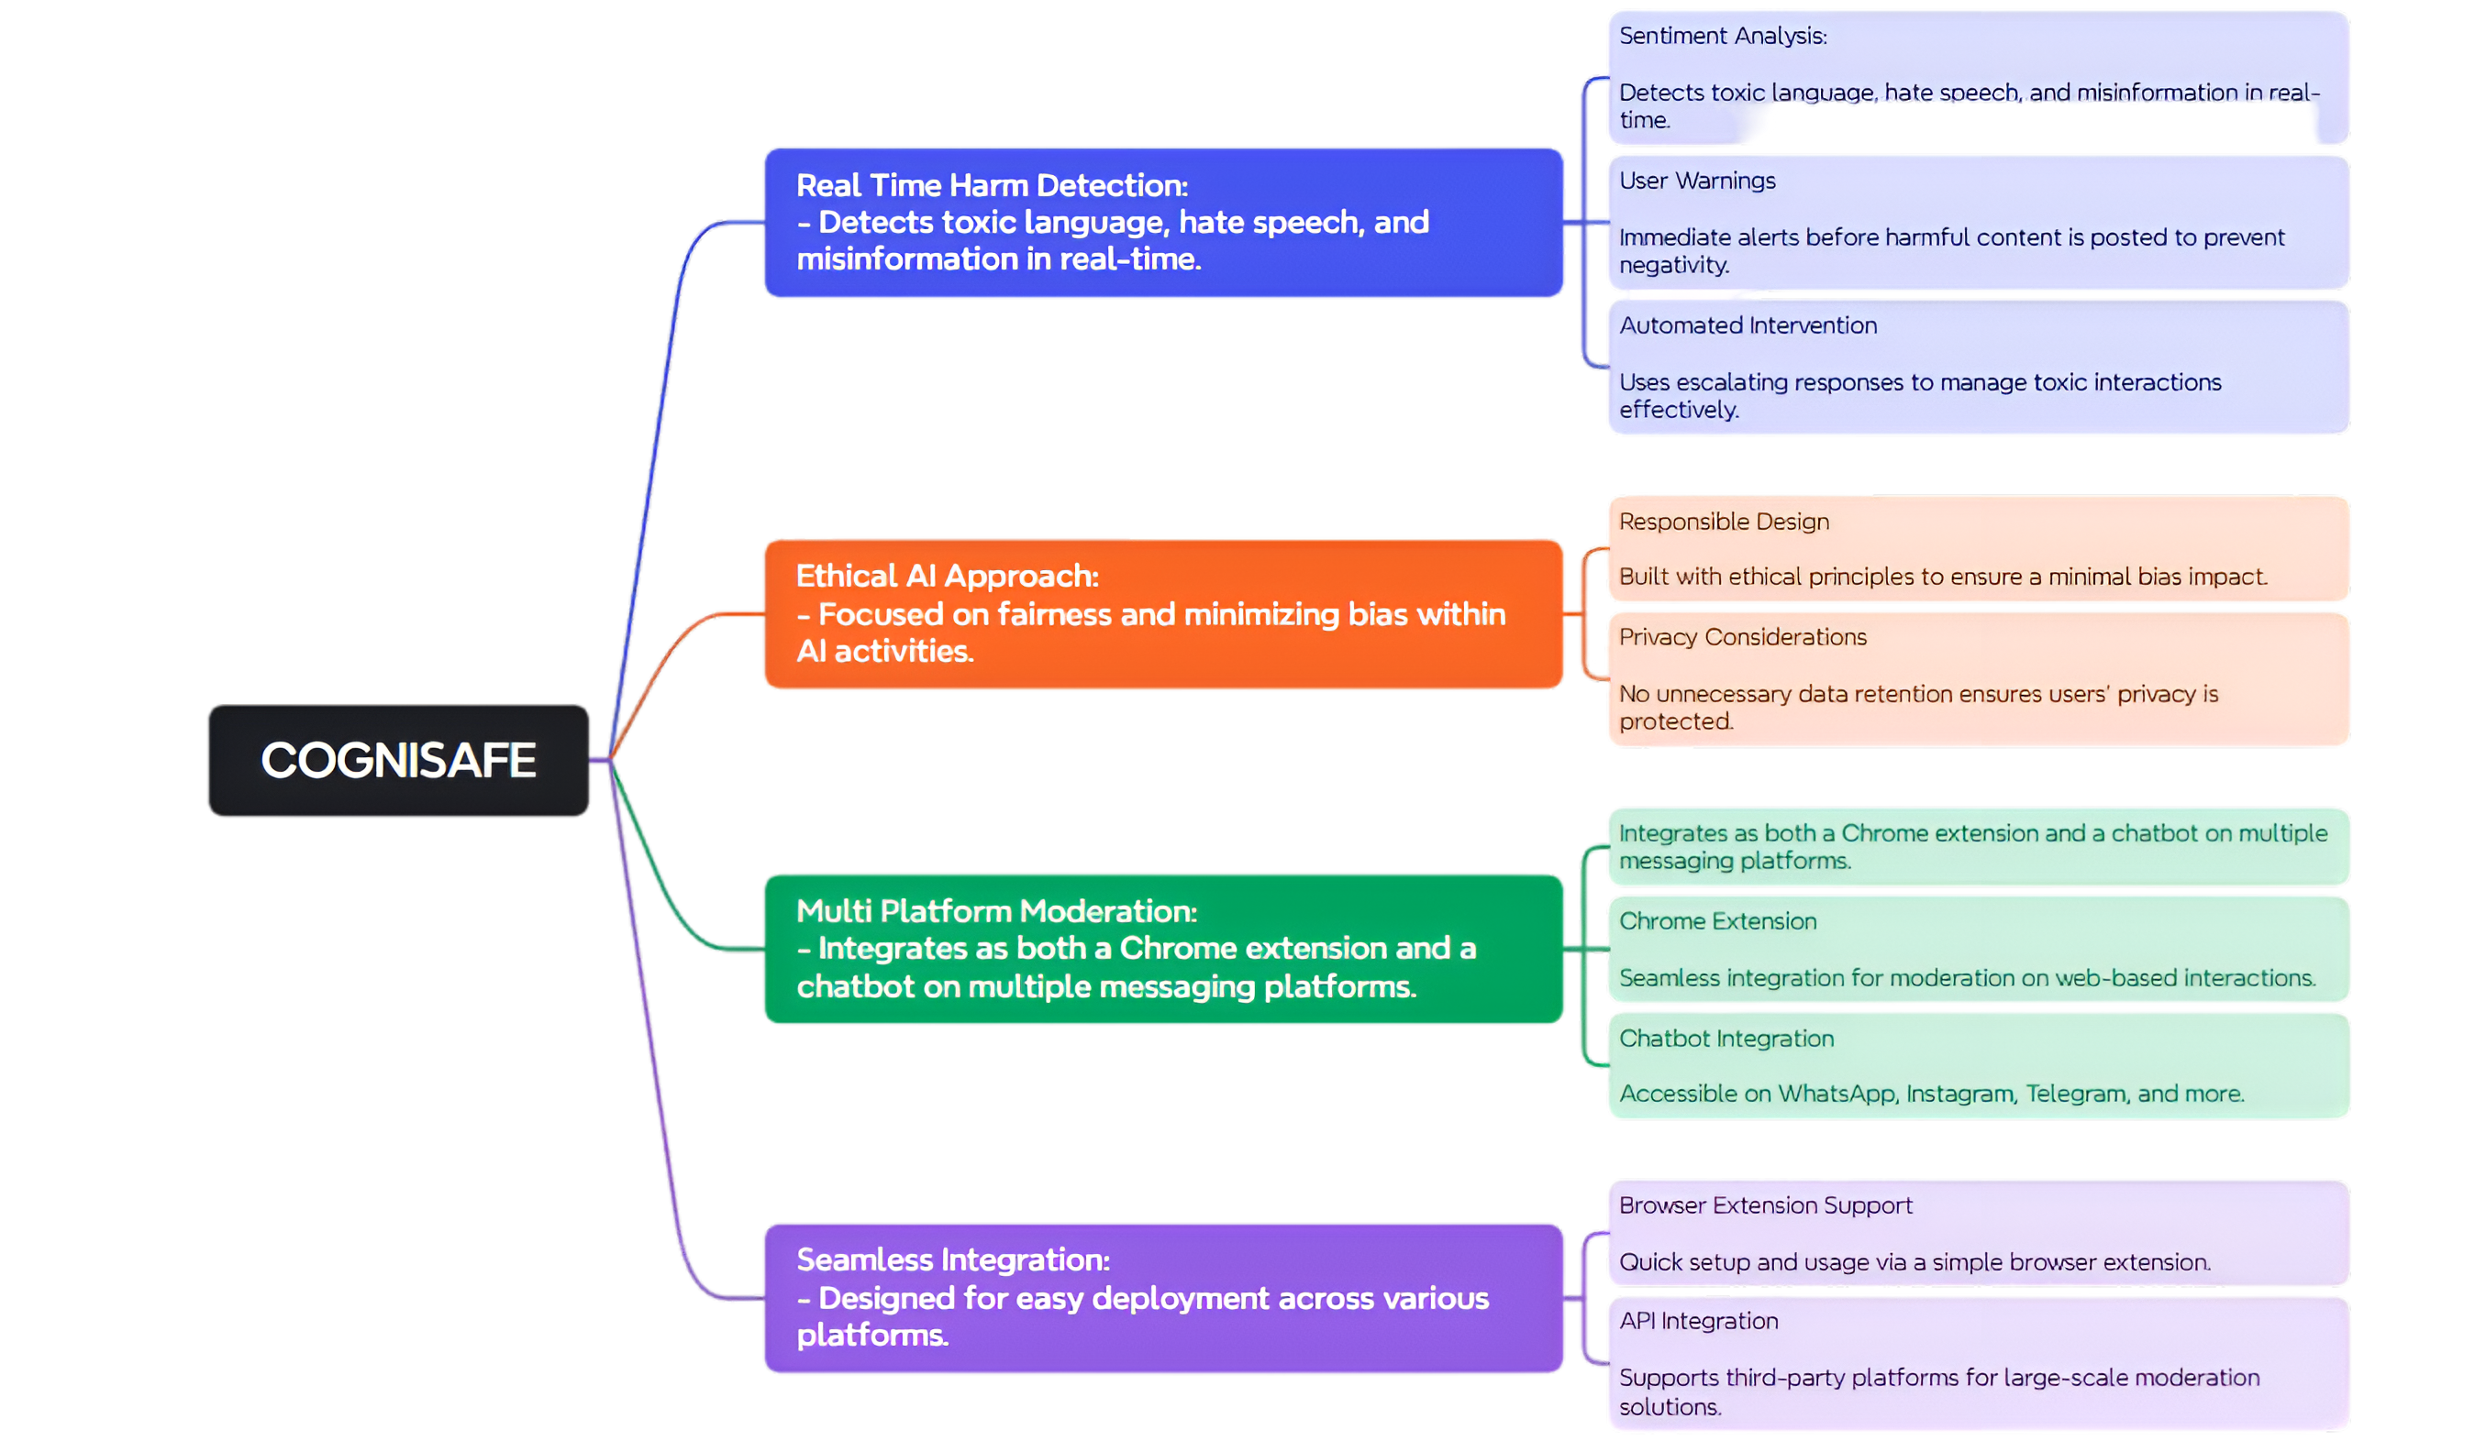
List of features offered by the solution:

Slide 5
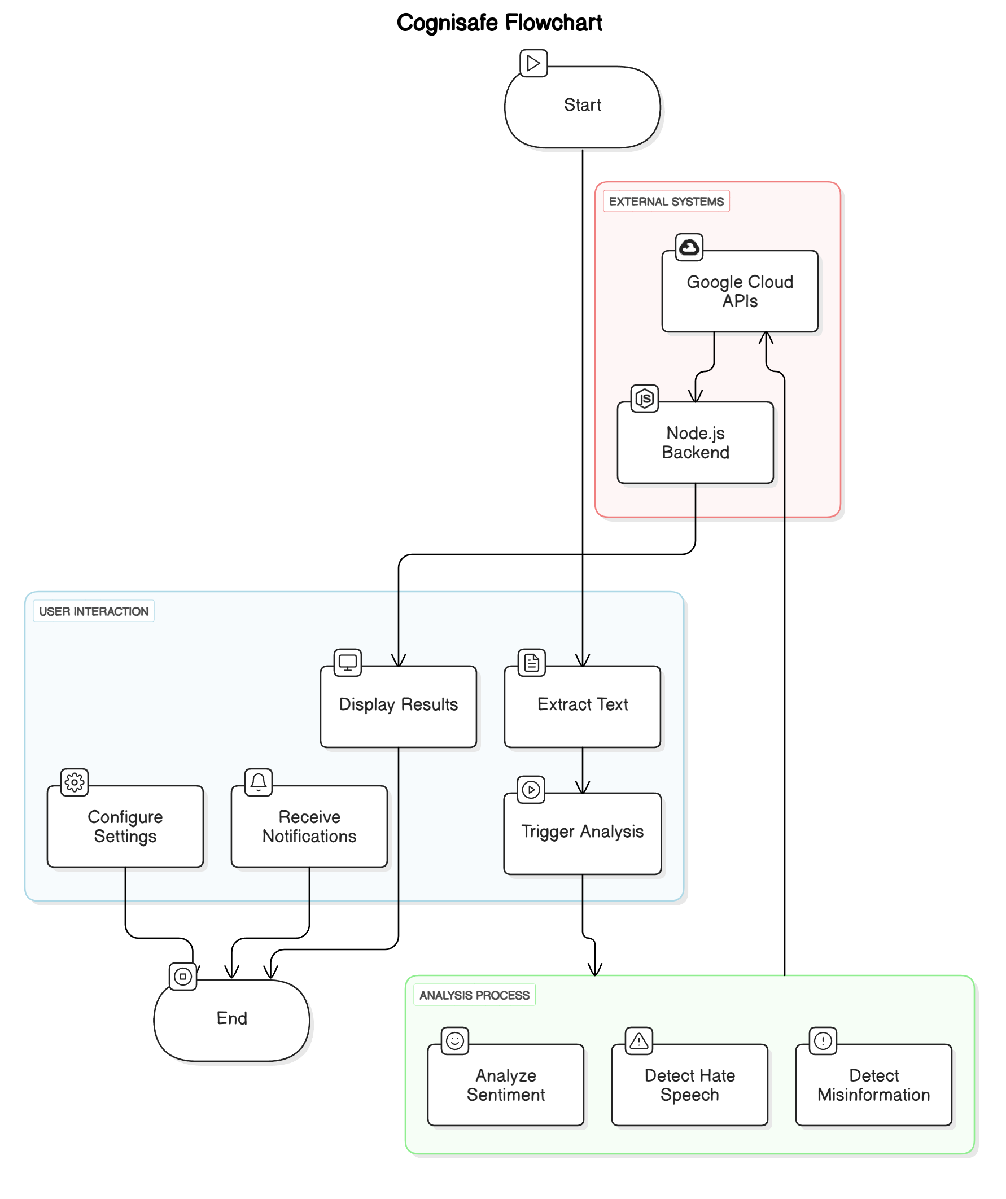
Process flow diagram or Use-case diagram

Slide 6
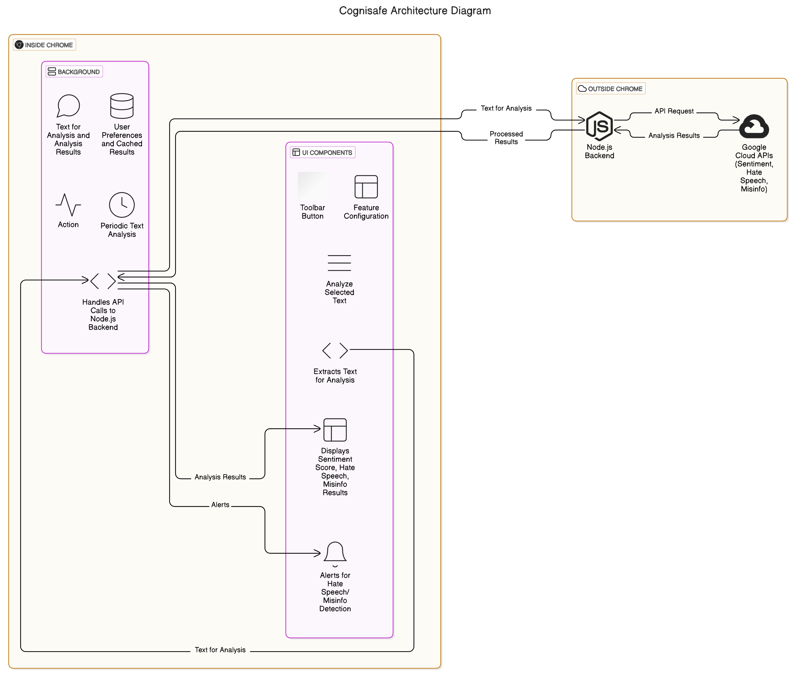
Architecture diagram of the proposed solution

Slide 7
Technologies used in the solution :
Frontend (Chrome Extension):
- HTML: Structures the extension popup UI.
- CSS: Styles the popup with responsive design and Google Fonts.
- JavaScript: Implements core extension logic.
- Chrome Extension APIs:
chrome.tabs: Monitors and interacts with active webpages.
chrome.scripting: Extracts and processes page text.
chrome.runtime: Facilitates communication between scripts.
Backend (Proxy Server):
- Node.js: Server-side runtime for efficient API proxying.
- Express.js: Lightweight web framework for routing API calls.
- Axios: HTTP client for making requests to Google APIs.
- Google APIs:
Natural Language API: Analyzes webpage sentiment (-1 to +1 scale).
Fact Check Tools API: Verifies misinformation claims.

Slide 8
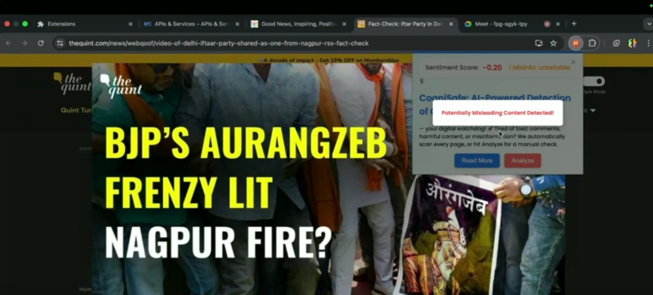
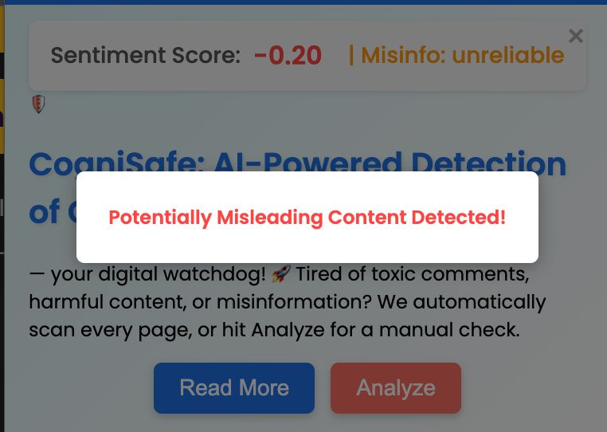
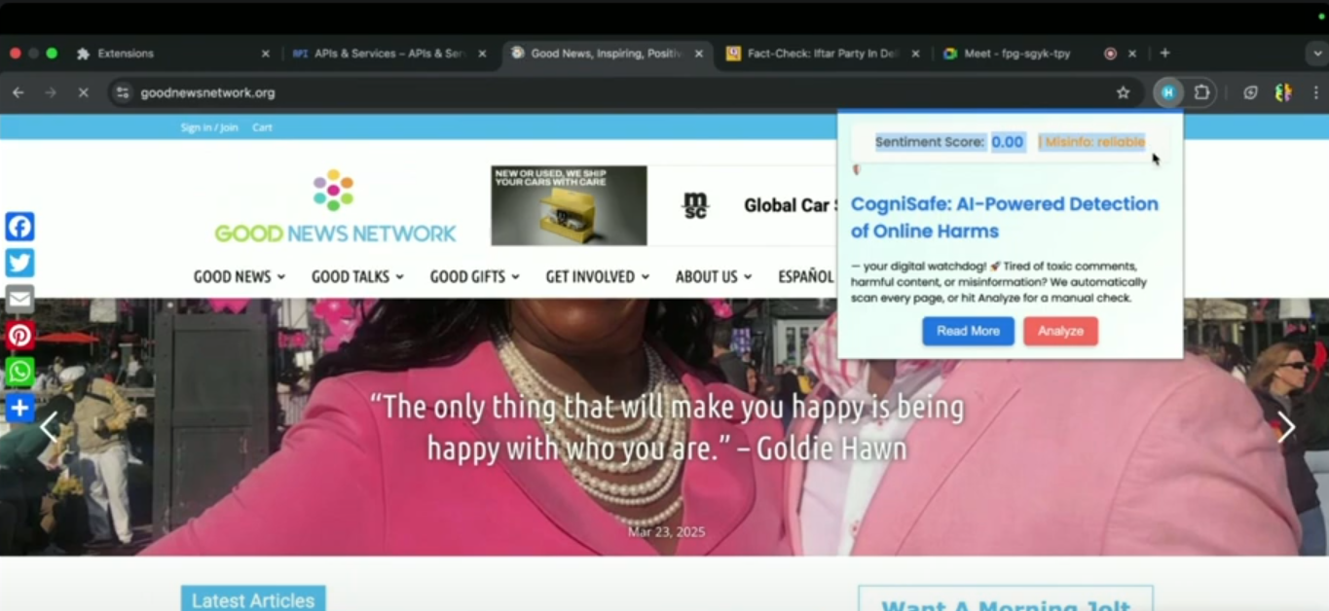
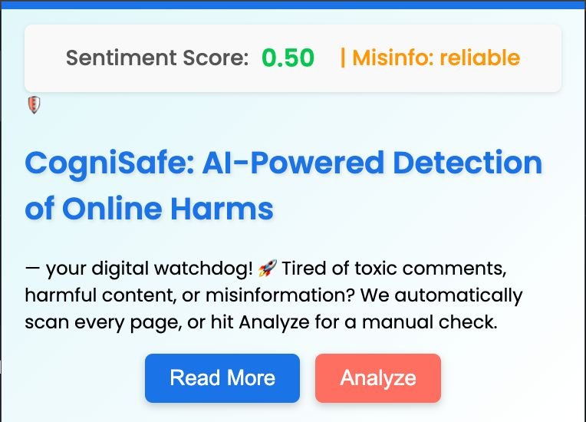
Snapshots of the MVP

Slide 9
Future Developments
Improved Fact-Checking Accuracy
2.User-Reporting Feature
- Currently, the extension matches URLs against fact-check databases.
- Future versions will extract key textual phrases from web pages to refine accuracy.
- A crowdsourced reporting system will allow users to flag potential misinformation.
- This will help identify emerging threats that fact-check databases may not cover yet.
3.Mobile and Platform Expansion
4.Advanced AI for Contextual Analysis
- We plan to extend CogniSafe to mobile browsers for wider accessibility.
- Integration with platforms like X (formerly Twitter) is also under consideration
- Leveraging Google’s Gemini and other AI models can enhance content analysis.
- This would provide a deeper understanding of misinformation patterns.
5.Chatbot for Real-Time Assistance
A bot will be integrated into group communities (e.g., WhatsApp, Instagram).
It will monitor conversations, detect harmful content, and issue warnings.
If repeated violations occur, it can block and report offenders.
Vision: CogniSafe is built on a strong foundation and will continue to evolve into a comprehensive tool for online safety, protecting users from misinformation and harmful content.

Slide 10
Provide links to your:
GitHub Public Repository :
Demo Video Link (3 Minutes) :
MVP Link :
https://github.com/gauthamkola/Cognisafe.git
https://youtu.be/ge9XguVj3EQ?si=O7DP7vxljAnGv7Cz
https://github.com/gauthamkola/Cognisafe.git

Slide 11


